Slide 1


Slide 2

Housekeeping
All participant video & microphones are muted during presentations.
Use the Q&A button to submit your questions for the speakers. We will get to as many questions as we can.
Closed captioning can be turned on using the Show Captions button.
The webinar will be recorded and shared with participants via email.
Please bear with us through any network disruptions.

Slide 3
Agenda
Time | Session
5 min | Keynote address
5 min | Overview of Ethiopia GAP Implementation
10 min | Presentation: Ethiopia national action plan for integrating early detection and treatment of wasting
10 min | Presentation: Ethiopia operational plan for the integration of early detection and treatment of wasting into routine health care services.
30 min | Panel discussion- call for action
 | Gelila Zewdu, Senior Nutrition Advisory, MOH, Ethiopia
 | Stanley Chitekwe, Chief of Nutrition, UNICEF, Ethiopia
 | Dr. Sisay Sinamo Boltena, Senior Programme Manager, Seqota Declaration, Federal Programme Delivery Unit, Ethiopia
 | Muluneh Girma, Head of Department – Nutrition and Health, Action Against Hunger, Ethiopia
20 min | Participant Q&A
5 min | Ways forward and closing remarks

Slide 4

Hiwot Intro

Slide 5
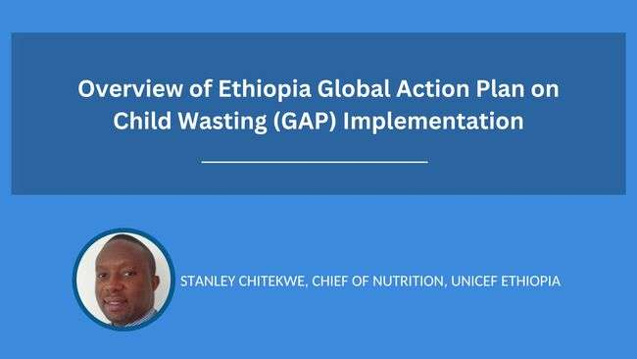

Slide 6

Ethiopia GAP progress in Ethiopia

Slide 7
GAP Development 2021-2025
Outcome | Annual Cost | 5Yr Cost
Outcome 1: Reduced incidence of Low Birth Weight | $ 25,094,360.00 | $ 125,471,800.00
Outcome 2: Improved Child Health | $ 12,273,600.00 | $ 61,368,000.00
Outcome 3: Improved Infant and Young Child Feeding | $ 15,167,144.00 | $ 75,835,720.00
Outcome 4: Improved treatment of children with wasting |  | $ -
Total |  | $262,675,520
UNICEF Ethiopia the led development of the GAP in collaboration with FMOH and sister UN agencies (UNHCR, WFP, FAO and WHO).
The request for this road map is 60 million USD a year. Of which, >50% is for outcome 1: Reduced incidence of Low Birth Weight.
We had not included the cost of treatment in output 4 to focus mainly on the prevention side of the GAP. The addition of it would have increased the budget by at least 300 million USD.

Slide 8


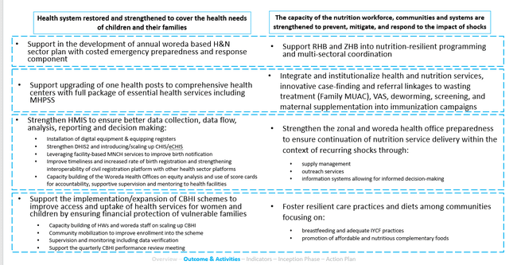
Progress
KFW – UNICEF Health, Nutrition, WASH resilience project for drought
Duration | 4 years (Jan 2023 – Jan 2026)
Budget

Slide 9
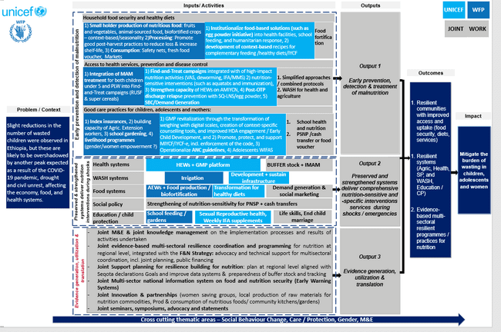
Progress
FCDO supported UNICEF – WFP Joint Resilience in fragile areas of Ethiopia
Duration | 3 years (Jan 2023 – Jan 2025)
Budget | Initial to be top up after June 2023

Slide 10

Progress
UNICEF-CIFF Grant on resilience in drought affected regions
Project description | To mitigate the burden of wasting in drought-affected zones of Ethiopia
Duration | 3 years (Oct 2022 – Oct 2025)
Budget | $ USD 15 M
Timeline | 6 months of design phase: formative stage to identify context-specific factors to address the underlying and immediate causes of malnutrition 32 months of implementation phase
Activities | Service delivery: RUTF for MAM treatment (10% conc. Illnesses at higher risk of mortality) MHNTs Multi-sectoral Find-and-Treat campaigns Revitalization of GMP Cash transfers for dietary diversity Post-discharge OTP: relapse prevention | Strengthening systems: Strengthening Multisector Coordination (with TA) Planning for Resilience Building to Nutrition Strengthening Social Protection Systems | Evidence mobilization: Context-specific deprivation analyses jointly developed learning agenda End-User Monitoring
Regional focus | Afar, Oromia, Somali

Slide 11
UNHCR-UNICEF Refugee progress key Nutrition Actions Implemented 2022
Progress
Community engagement and involvement: 2,967 ( 2500 mother to mother support groups (MtMSGs) and 467 father to father support groups (FTFSGs)) reaching estimated 25,000 Pregnant nd lactating women and 4,670 fathers of young children under the age of two years
Infant and young child Feeding (IYCF) promotion:_17,203 monthly
Micronutrient deficiency control and prevention of undernutrition supported: 98,175 (90.6%) children 6-59 were supplemented with Vitamin A and deworming tablets
38,841 Households (~201,415 Individuals) Supported Small scale Gardening, animal husbandry and Poultry distribution
Capacity Building and systems strengthening on Nutrition themes (CMAM, IYCF, FMUAC, MAMI, MTMSG): 2,904 and 28 SENS mangers training December 2022
Countrywide supportive monitoring and impact evaluations except Shire
Simplified approaches through FMUAC and MAMI:29,430 individuals monthly
Cash based interventions targeting households with children 6-23 months, PLW: 23301 (~124,053 individuals)

Slide 12
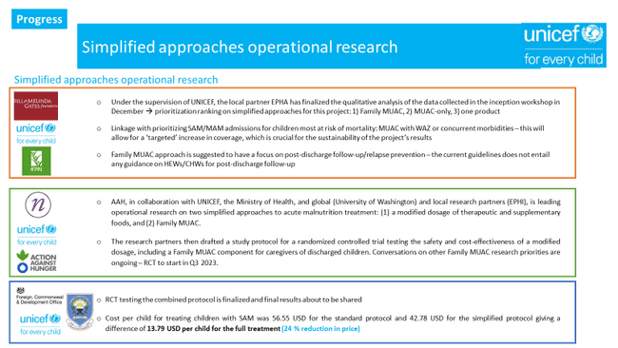

Slide 13

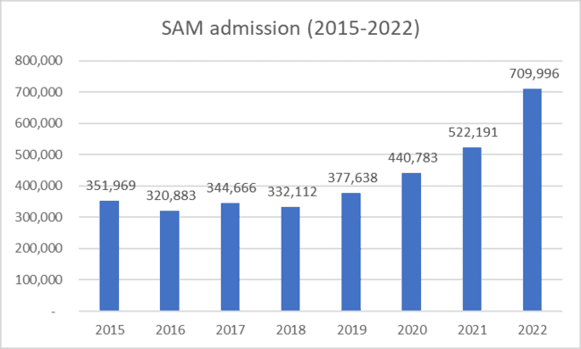
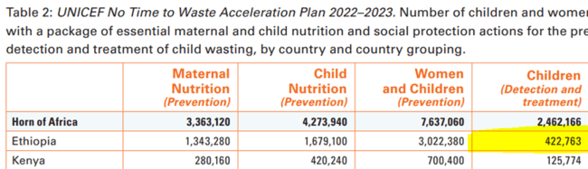
KEY RESULTS FROM NTTW
Stabilized resource needs for wasting treatment scale up in Ethiopia,
710,000 children reached in 2022
UNICEF was able to secure 410,450 cartons of RUTF (5,700 MT) – ensuring healthy pipeline until October 2023
Provision of F75, F100 and routine drugs
Supported Training on AM guidelines
Scale up Partnerships
Moreover, this project will continue the implementation of a rapid response mechanism approach, the so-called F&T campaign, allows for both active SAM case-finding, but also nutrition situation assessment, and delivery of high impact nutrition services (Vitamin A supplementation, deworming, IFA)

Slide 14
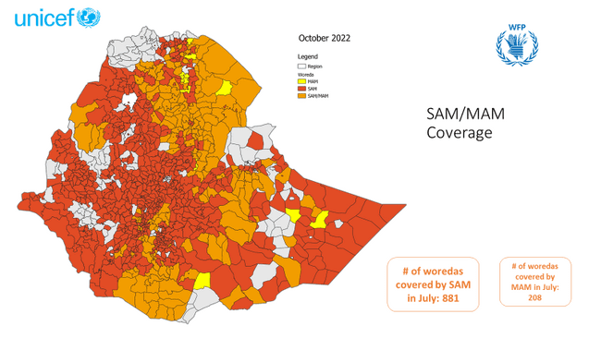

Slide 15





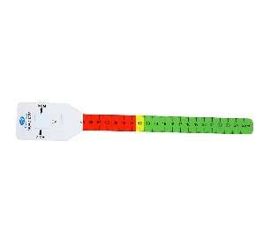
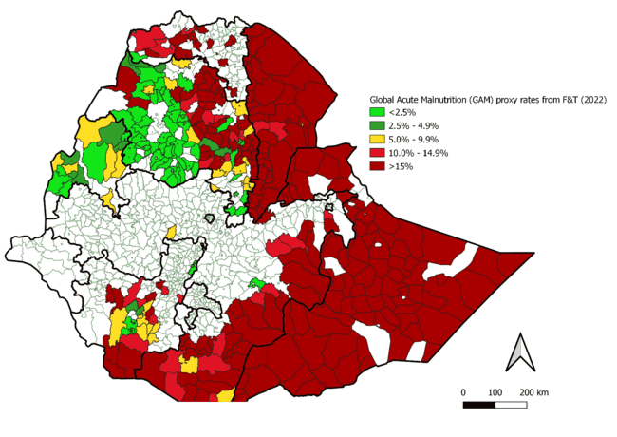
Find-and-treat campaign – delivered integrated results in drought and conflict
El Niño-Driven Nutrition Emergency in Ethiopia
Ethiopia
As of 27 April 2016
Key initiatives
9,423,554
1,958,095
8
Regions
68
Zones
521
Woredas
children U5
PLW
2022 Achievements
children U5
# linked to SAM treatment
40,578
MUAC screening
# received VAS
2,174,119
# received deworming
1,141,914
# received MAM treatment
209,961
PLW
# PLW received IFA
85,901
# caregivers were counselled on IYCF
708,393
# received MAM treatment
170,969

Slide 16
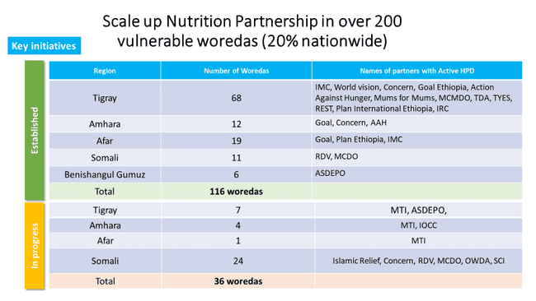

Slide 17
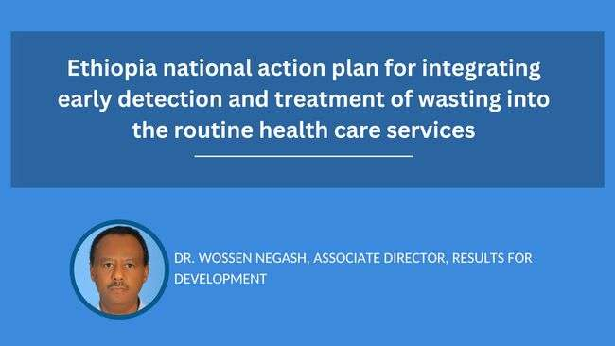

Slide 18


What do we mean by wasting and integration?
WASTING
INTEGRATION
Encompasses all forms of acute malnutrition including those diagnosed using WHZ
(<-2WHZ), oedema and/or MUAC (<125mm).
Improving ability to screen, refer and treat children with wasting by integrating these services within routine health care system

Slide 19
Many forms of integration are possible across components of the health system
Health system components
Leadership & Governance
Sustainable Financing
Supply Chain
Information Systems
Service Delivery
Health Workforce
Emergency Preparedness & Resilience

Slide 20
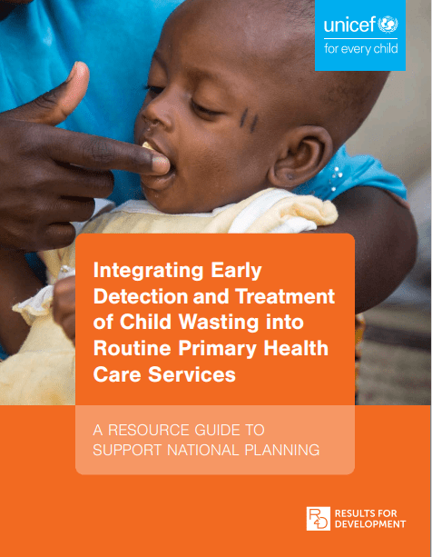
The process in Ethiopia builds off a global guide developed by Results for Development & UNICEF
The guide offers a 6-step process for governments to identify ways to integrate the early detection and treatment of child wasting within routine primary health care services
The full guide can be found here

Slide 21
The process in Ethiopia included the following six steps:
Step 1
Technical working group (TWG) established and TOR/workplan developed
Step 2
Program goals articulated
Step 3
Rapid assessment conducted to explore the successes, major constraints and enablers of integration
Step 4
Set of integration actions identified to address constraints
Step 5
TWG reviewed and revised draft action plan
Step 6
Action plan validated by federal, regional and partner representatives

Slide 22






Integration objectives articulated in the national plan to integrate wasting management into PHC
Increase coverage and equity of services
Reduce costs and increase efficiencies
Increase sustainability (programmatic & financial)

Slide 23

Constraints and proposed actions:
Leadership & Governance
LEADERSHIP & GOVERNANCE
Constraints
Governance and accountability for moderate wasting services across sectors need to be strengthened
Uncertain sustainability of wasting services due to continued reliance on external partners
Actions
Ensure wasting services within health workforce capacity development strategies and plans
Strengthen efforts to develop multi-stakeholder plans to transition implementation of wasting services from external partners to the health sector

Slide 24


Constraints and proposed actions:
Service Delivery
LEADERSHIP & GOVERNANCE
SERVICE DEIVERY
Constraints
Governance and accountability for moderate wasting services across sectors need to be strengthened
Uncertain sustainability of wasting services due to continued reliance on external partners
Actions
Ensure wasting services within health workforce capacity development strategies and plans
Strengthen efforts to develop multi-stakeholder plans to transition implementation of wasting services from external partners to the health sector
Constraints
Insufficient screening and early detection of child wasting and low demand for services
Low treatment coverage for moderate wasting services
Actions
Integration of tasks related to the screening & referral to community-volunteers and families and in other programs such as immunization
Increase geographic coverage for moderate wasting services by providing wasting treatment (outpatient and/or inpatient) in additional facilities

Slide 25

Constraints and proposed actions:
Health Workforce
LEADERSHIP & GOVERNANCE
SERVICE DEIVERY
HEALTH WORKFORCE
Constraints
Governance and accountability for moderate wasting services across sectors need to be strengthened
Uncertain sustainability of wasting services due to continued reliance on external partners
Actions
Ensure wasting services within health workforce capacity development strategies and plans
Strengthen efforts to develop multi-stakeholder plans to transition implementation of wasting services from external partners to the health sector
Constraints
Insufficient screening and early detection of child wasting and low demand for services
Low treatment coverage for moderate wasting services
Actions
Integration of tasks related to the screening and referral to community-volunteers and families
Increase geographic coverage for moderate wasting services by providing wasting treatment (outpatient and/or inpatient) in additional facilities
Constraints
Limited capacity of health staff to deliver wasting services
Missed opportunities for joint planning and prioritization exercises for health and nutrition programs
Actions
Ensure representatives from relevant health teams and other departments are included in nutrition prioritization discussions during annual and routine planning
Empower mothers to detect acutely wasted children under 2 years old

Slide 26

Constraints and proposed actions:
Information Systems
LEADERSHIP & GOVERNANCE
SERVICE DEIVERY
HEALTH WORKFORCE
INFORMATION SYSTEMS
Constraints
Governance and accountability for moderate wasting services across sectors need to be strengthened
Uncertain sustainability of wasting services due to continued reliance on external partners
Actions
Ensure wasting services within health workforce capacity development strategies and plans
Strengthen efforts to develop multi-stakeholder plans to transition implementation of wasting services from external partners to the health sector
Constraints
Insufficient screening and early detection of child wasting and low demand for services
Low treatment coverage for moderate wasting services
Actions
Integration of tasks related to the screening and referral to community-volunteers and families
Increase geographic coverage for moderate wasting services by providing wasting treatment (outpatient and/or inpatient) in additional facilities
Constraints
Limited capacity of health staff to deliver wasting services
Missed opportunities for joint planning and prioritization exercises for health and nutrition programs
Actions
Ensure representatives from relevant health teams and other departments are included in nutrition prioritization discussions during annual and routine planning
Empower mothers to detect acutely wasted children under 2 years old
Constraints
Limited availability of high-quality wasting data to routinely monitor burden, coverage, and performance
Gaps in evidence translation and use of wasting data in health sector decision-making
Actions
Promote data and system integration across several information systems that contain information for wasting indicators
Ensure wasting data is routinely available to decision-makers

Slide 27

Constraints and proposed actions:
Sustainable Financing
LEADERSHIP & GOVERNANCE
SERVICE DEIVERY
HEALTH WORKFORCE
INFORMATION SYSTEMS
SUSTAINABLE FINANCING
Constraints
Governance and accountability for moderate wasting services across sectors need to be strengthened
Uncertain sustainability of wasting services due to continued reliance on external partners
Actions
Ensure wasting services within health workforce capacity development strategies and plans
Strengthen efforts to develop multi-stakeholder plans to transition implementation of wasting services from external partners to the health sector
Constraints
Insufficient screening and early detection of child wasting and low demand for services
Low treatment coverage for moderate wasting services
Actions
Integration of tasks related to the screening and referral to community-volunteers and families
Increase geographic coverage for moderate wasting services by providing wasting treatment (outpatient and/or inpatient) in additional facilities
Constraints
Limited capacity of health staff to deliver wasting services
Missed opportunities for joint planning and prioritization exercises for health and nutrition programs
Actions
Ensure representatives from relevant health teams and other departments are included in nutrition prioritization discussions during annual and routine planning
Empower mothers to detect acutely wasted children under 2 years old
Constraints
Limited availability of high-quality wasting data to routinely monitor burden, coverage, and performance
Gaps in evidence translation and use of wasting data in health sector decision-making
Actions
Promote data and system integration across several information systems that contain information for wasting indicators
Ensure wasting data is routinely available to decision-makers
Constraints
Unsustainable, fragmented, and inefficient funding
Insufficient funding to meet the need
Actions
Increase domestic resource allocation to wasting services by ensuring adequate prioritization in health sector budgets
Track on- and off-budget funding for wasting services in accordance with targets established in national plans

Slide 28

Constraints and proposed actions:
RUTF Supply
LEADERSHIP & GOVERNANCE
SERVICE DEIVERY
HEALTH WORKFORCE
INFORMATION SYSTEMS
SUSTAINABLE FINANCING
RUTF SUPPLY
Constraints
Limited capacity of health staff to deliver wasting services
Missed opportunities for joint planning and prioritization exercises for health and nutrition programs
Actions
Ensure representatives from relevant health teams and other departments are included in nutrition prioritization discussions during annual and routine planning
Empower mothers to detect acutely wasted children under 2 years old
Constraints
Limited availability of high-quality wasting data to routinely monitor burden, coverage, and performance
Gaps in evidence translation and use of wasting data in health sector decision-making
Actions
Promote data and system integration across several information systems that contain information for wasting indicators
Ensure wasting data is routinely available to decision-makers
Constraints
Under-prioritization of RUTF as an essential commodity
Inefficient RUTF Supply chain and weak last mile distribution
Actions
Include RUTF in national prioritization processes for essential commodities
Ensure RUTF stock is managed by staff trained in logistics and inventory management at the sub-national level
Constraints
Governance and accountability for moderate wasting services across sectors need to be strengthened
Uncertain sustainability of wasting services due to continued reliance on external partners
Actions
Ensure wasting services within health workforce capacity development strategies and plans
Strengthen efforts to develop multi-stakeholder plans to transition implementation of wasting services from external partners to the health sector
Constraints
Insufficient screening and early detection of child wasting and low demand for services
Low treatment coverage for moderate wasting services
Actions
Integration of tasks related to the screening and referral to community-volunteers and families
Increase geographic coverage for moderate wasting services by providing wasting treatment (outpatient and/or inpatient) in additional facilities
Constraints
Unsustainable, fragmented, and inefficient funding
Insufficient funding to meet the need
Actions
Increase domestic resource allocation to wasting services by ensuring adequate prioritization in health sector budgets
Track on- and off-budget funding for wasting services in accordance with targets established in national plans

Slide 29
Constraints and proposed actions across health system components
LEADERSHIP & GOVERNANCE
SERVICE DEIVERY
HEALTH WORKFORCE
INFORMATION SYSTEMS
SUSTAINABLE FINANCING
RUTF SUPPLY
Constraints
Governance and accountability for moderate wasting services across sectors need to be strengthened
Uncertain sustainability of wasting services due to continued reliance on external partners
Actions
Ensure wasting services within health workforce capacity development strategies and plans
Strengthen efforts to develop multi-stakeholder plans to transition implementation of wasting services from external partners to the health sector
Constraints
Insufficient screening and early detection of child wasting and low demand for services
Low treatment coverage for moderate wasting services
Actions
Integration of tasks related to the screening & referral to community-volunteers and families and in other programs such as immunization
Increase geographic coverage for moderate wasting services by providing wasting treatment in additional facilities
Constraints
Limited capacity of health staff to deliver wasting services
Missed opportunities for joint planning and prioritization exercises for health and nutrition programs
Actions
Ensure representatives from relevant health teams and other departments are included in nutrition prioritization discussions during annual and routine planning
Empower mothers to detect acutely wasted children under 2 years old
Constraints
Limited availability of high-quality wasting data to routinely monitor burden, coverage, and performance
Gaps in evidence translation and use of wasting data in health sector decision-making
Actions
Promote data and system integration across several information systems that contain information for wasting indicators
Ensure wasting data is routinely available to decision-makers
Constraints
Unsustainable, fragmented, and inefficient funding
Insufficient funding to meet the need
Actions
Increase domestic resource allocation to wasting services by ensuring adequate prioritization in health sector budgets
Track on- and off-budget funding for wasting services in accordance with targets established in national plans
Constraints
Under-prioritization of RUTF as an essential commodity
Inefficient RUTF Supply chain and weak last mile distribution
Actions
Include RUTF in national prioritization processes for essential commodities
Ensure RUTF stock is managed by staff trained in logistics and inventory management at the sub-national level

Slide 30
Thank you for listening
A big thank you to the members of the technical working group!
Notes:
-Thanks a lot for listening-over to you Yosef.

Slide 31
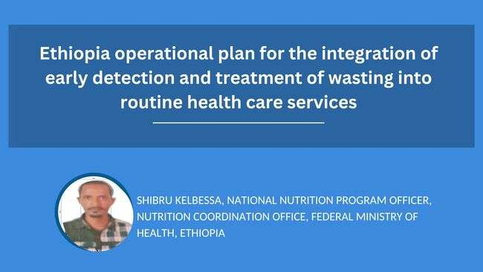

Slide 32
Process of developing the national integration plan
TWG was established and led the process
A rapid assessment was conducted to explore the success, major constraints and enablers to integrate early detection and treatment of child wasting into the routine health care system
Based on the findings, a set of integration actions that can help address the constraints developed.
The TWG reviewed the draft action in a workshop and amended as appropriate
The draft was then reviewed and adjusted several times by FMOH and TWG
The action plan was reviewed and was validated by regions representatives and partners

Slide 33
Reflections from the regional convening
Key highlights from the Regional Convening:
  Regional focal points emphasized the need to take a holistic, integrated approach to scaling wasting treatment through PHC
  Develop operational plan with detailed activities and budget
  The operational plan should be part of annual planning and budgeting
  Having a clearer view of all development activities and funding will help improve strategic planning

Slide 34
Based on the integration plan, an operational plan was developed for the next 2.5 years
The budget plan consists of:
  prioritized health sector components and the proposed actions
  assumptions for costing and costs for Ethiopian fiscal year 2015, 2016, 2017 (2023-2025)
  cost by health sector component and total cost
Budget plan
Estimated cost over the next 3 years:
3.2 billion ETB
$60 million USD

Slide 35


Slide 36
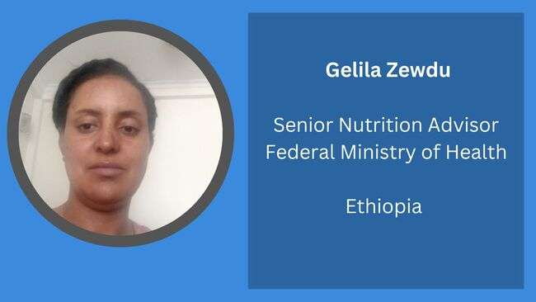

Slide 37

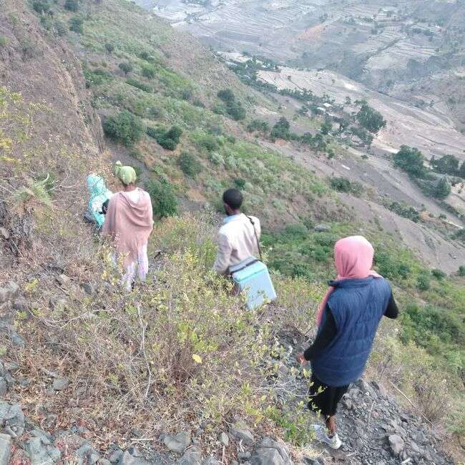

Integrated Measles SIA and Nutrition Services
National Campaign
March, 2023

Slide 38
Introduction
Ethiopia has been facing various natural and human-made disasters such as conflicts, covid-19, flooding, drought etc. that caused significant interruption of essential services including basic nutrition and immunization services.
The coverage of high-impact and low-cost nutrition such as Vitamin A Supplementation, Deworming, Growth Monitoring and Promotion and Nutrition screening are low in many parts of Ethiopia.
Moreover, there are missed opportunities of nutrition interventions in Expanded Program Immunization (EPI) programs and immunization services during nutrition interventions including nutrition screening and treatment. Moreover, nutrition is missed during EPI campaigns.
The need for nutrition has currently increased due to the presence of multiple shocks in the country such as Climate (Droughts, Floods, Locusts), Conflict, inflation and communicable disease outbreak (COVID 19)''.
MOH planned to provide basic nutrition and child health services integrating using the catch up supplementary immunization activities (SIAs) of measles for 2022 for children 0-59 months age
Due to the suboptimal immunization coverage a significant amount of susceptible population has been accumulated over the past 3 years

Slide 39
Integrated Nutrition Services
Integration of nutrition interventions with measles SIA is the key strategy for improved reach and coverage of immunization and child nutrition services.
The integrated campaign planned to benefit both nutrition and immunization services by improving coverage, tracing dropouts, and reach the unreached children and accelerate the efforts for prevention of malnutrition and vaccine preventable diseases.
Nutrition services integrated are :
  Screening for acute malnutrition
  Vitamin A supplementation(6 -59 month)
  Deworming(24 -59 month)
The nationwide measles SIA integrated with child nutrition services was planned to be conducted in 12 regional states targeted to reach more than 15 million children 0 to 59 months of age
Campaign was conducted starting from December 22/2022 for 10 days

Slide 40
Pre and intra campaign Integrate activities
Planning and Coordination
Task forces established from both immunization and nutrition (Monitoring and evaluation TWG, Supply & logistics Management TWG, Communication & social mobilization TWG )
TOR for coordination of the integrated SIA was prepared and shared to regions
Micro planning and implementation TOT provided at national level
Training cascading (regions at different status level)
RAT follow up every week
At the national level the SIA was led by state minister/programs/ and director of maternal, child health and nutrition directorate
Communication
Different advocacies (health professional associations, PR directors of Minister offices, and media professionals)
TV and radio message developed; Short SMS massages transmitted through Ethio telecom
Banners and poster developed and printed through UNICEF and regions.

Slide 41
Activities ….
Supply and Logistics Distribution
Quantification done and distribution was made through EPSS
Vitamin A capsule
Albedazole Tabs
M & E tools
Banners
MUAC taps
Resource mobilization
Total of 1, 816,583 USD was mobilized for nutrition
In kind contributions included Vitamin A capsule, Vehicles, MUAC tape, print materials
Resource was used mainly to cover for additional providers for nutrition services

Slide 42
Supportive Suppervision
Nation wide about 407 experts from partners and gov’t have participated in the campaign
The supportive supervision was done through ODK,
Google sheet platform was also used for daily reporting of campaign performance and monitoring
Daily campaign performance monitoring and feed back at all levels

Slide 43
Integrated Campaign Performance
Nutritional Screening

Slide 44
Campaign Performance…
Vit- A and Deworming Performance

Slide 45
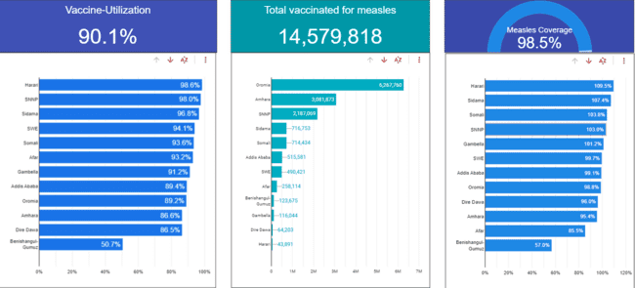

Slide 46
Challenges
Security Problem
  Benishangul Gumuz – 7 Woredas
  Oromia Region – 12 Woredas campaign cannot be performed
Vit A shortages
Target population issues
Zero dose children identification_low

Slide 47
Best practices
The senior management at MOH, RHBs, ZHDs, woreda health office lead the campaign.
Pre campaign preparation was optimal
There was consensus on the rationale and need of the integration between center and regions
Integration was systematically at all stages (preparatory, implementation and post campaign evaluation) and all activities(planning, guidance, training, communication, distribution and monitoring).
Involvement of all stakeholders

Slide 48
Thank you!

Slide 49


Slide 50
Best practices and key lessons
Match Funding: The government of Ethiopia has committed to invest US$ 1.3 million per year for RUTF through a match funding mechanism total $2.6Million
VII Bridge Funding support from Supply Division and ESARO ensured stable pipeline
Find and Treat Campaigns Provided timely data for planning monitoring response.
Weekly Infographic helped engage donors and management on response progress and challenges

Slide 51
Challenges
Local capacity for RUTF production meets only <30% of national needs in 2022
Centres of excellence on resilience lacking and therefore need for effective and evidenced-based models on Resilience
In view of SQLNS pipeline constraints, there is need to accelerate food systems/egg powder production
Leverage government $$ investment in RUTF to reposition wasting strategically within ECD to unlock predictable funding from HDPF, UNSDAF (an elevation from OCHA/HNO/HRP)

Slide 52
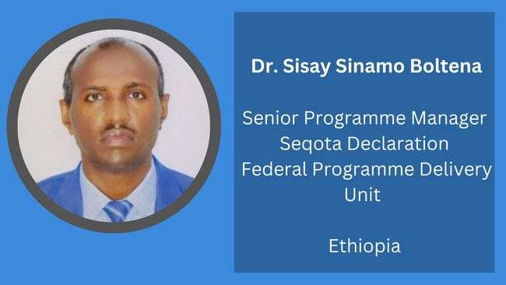

Slide 53
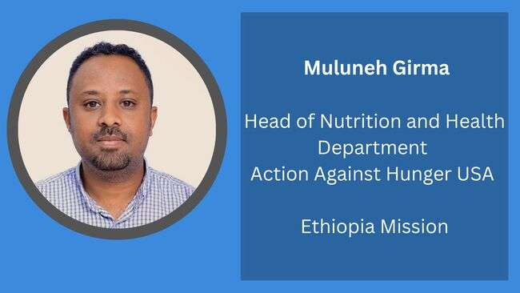

Slide 54

Successful ways to scale-up services for both the prevention and treatment of child wasting:
Action Against Hunger
March 23, 2023

Slide 55
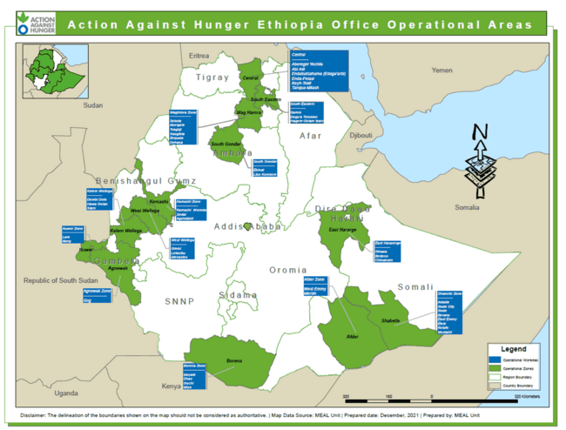
Action Against Hunger Operational Presence in Ethiopia.
Vision: To see a world free from Hunger.
Mission: To save lives by eliminating hunger through the prevention, detection and treatment of malnutrition, especially during and after emergency situations of conflict, war and natural disaster.
Regions | Districts | Refugee Camps
6 | 50 | 5 (In Gambella region)
Operational presence and dynamics hinge on multiple factors, including response rationale, availability of funding, and security and access issues.

Slide 56
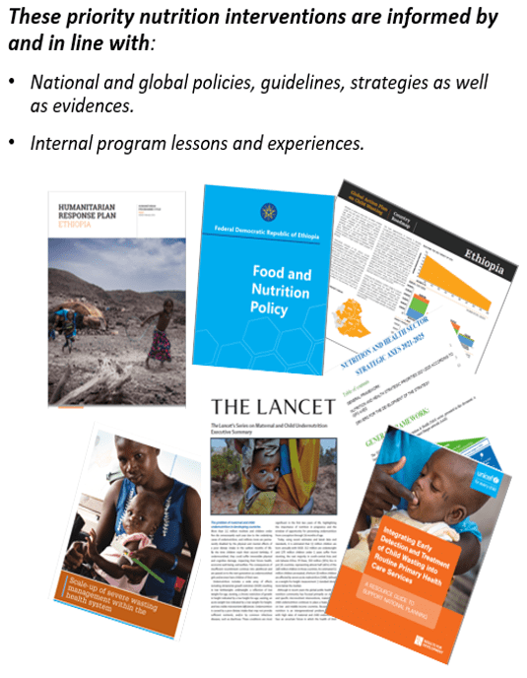
Priority Nutrition Interventions in Action Against Hunger: In a nutshell
Community
Early detection, referral , admission & treatment of wasting
Nutrition Surveillance, survey and EWS
Capacity building
Gender & protection mainstreaming activities
Nutrition Supply Management System
Maternal Infant & Young Child Nutrition (MIYCN) and care practices
Treatment of Sever & Moderate Acute Malnutrition
Procurement of lifesaving essential nutrition supplies & medicines
Research, Innovation and Learning
Advocacy and lobbying
Coordination, collaboration and partnership

Slide 57
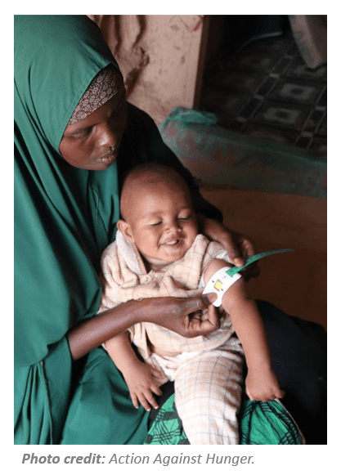
Innovative/adaptive Nutrition Intervention Approaches: Family MUAC Approach
Experience so far:
Action Against Hunger has been implementing Family MUAC approach in five refugee camps and 10 host community districts (mostly drought and conflicts affected areas) since 2020 prompted by COVID-19 adaptive nutrition measures.
It has been implemented in line with the draft national/MoH guide for FM implementation and as per the nutrition cluster guidance.
Promising results have been traced based on internal program data sources:
    More than 10, 800 mothers trained on Family MUAC in ten intervention areas.
    Nearly 80% correct self referral were made by trained mothers/caretakers and admissions and
    TFP case admissions increased by 10-15% from baseline situation.
Next steps:
Operational research on the effectiveness and cost-effectiveness of Family MUAC.
Development of consolidated case study on Family MUAC.
Significance for prevention and treatment of wasting in Ethiopia:
Places families at the center of malnutrition screening strategies.
Improves early identification of acute malnutrition and referral to treatment.
Increases community-based screening coverage.
Notes:
Extended notes:

Slide 58
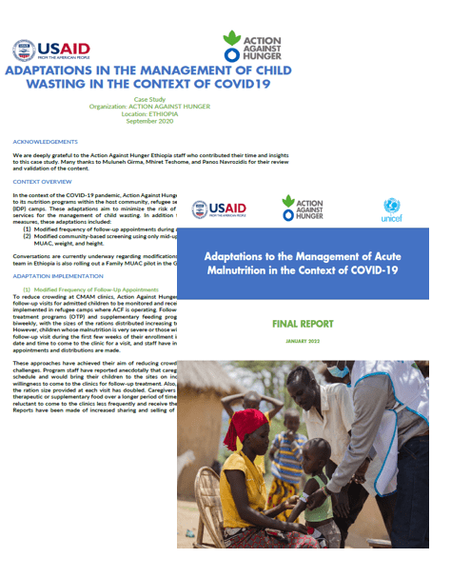
Innovative/adaptive Nutrition Intervention Approaches: In the context of COVID-19
National experience:
Action Against Hunger has applied key wasting prevention and treatment measures during COVID-19 peak pandemic seasons, which included:
  Family MUAC
  Modified Admission and Discharge Criteria
  Reduced Frequency of Follow-up Visits
  Use of smart phones/social media app (WhatsApp) to support CMAM in remote HPs
Lessons and documentations:
Lessons and success were documented in two major reports/case studies. National and multi-country.
Both are featured in major humanitarian news/information outlets: ENN and Relief web.
Significance for prevention and treatment of wasting in Ethiopia:
Ensures continuity of essential nutrition services at time of public health emergencies and crises.
Improves early identification of acute malnutrition and referral to treatment.

Slide 59
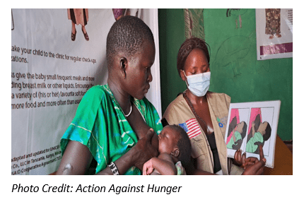
Innovative/adaptive Nutrition Intervention Approaches: MAMI care Pathway
National experience:
MAMI: Management of small & nutritionally at-risk infants under six months & their mothers.
Action Against Hunger has been implementing MAMI care pathway in four south suddenness refugee camps in Gambella region since 2020.
The program aims to improve nutritional status of mothers and children under-six month of age and promote linear growth and development of infant and young children by strengthening assessments of infants under 6 month and their mothers in the community and nutrition centers for routine screening and enrollment.
Lessons and documentations:
The program has improved early identification and enrollment of infants and their mothers who are nutritionally at risk into nutrition services.
Enhanced an integrated GMP, MIYCN and IMNCI services and referral linkage in refugee camps.
Development of standard case study on MAMI care pathway is underway.
Significance for prevention and treatment of wasting in Ethiopia:
It can be scaled up in host communities and integrated into existing services delivery modalities.
About 20% of Infants U6 months are small and nutritionally at risk (wasted, stunted and underweight) and hence require inclusive care services across the continuum of care in the health system.
Improves the prevention wasting and early identification and referral of small and nutritionally at risk infants and mothers to treatment.
More on MAMI care pathway: https://www.ennonline.net/mamicarepathway

Slide 60









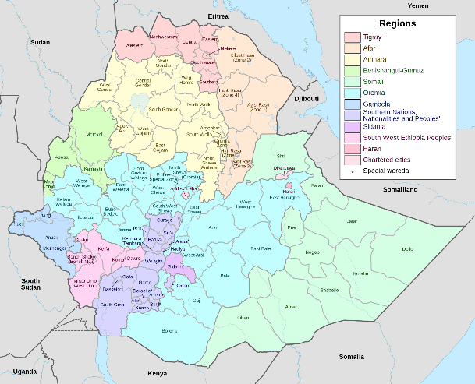


Research and Innovation: Simplified Approaches
1. Power of Nutrition (PON) Operational Research: Modified Dosage for Acute Malnutrition Trial (MODAM trial)
Aim and Objectives:
To assess the safety, effectiveness, and cost-effectiveness of modified dosage protocols for SAM and MAM treatment, as related to nutritional recovery, compared to standard national protocols
To assess the safety, effectiveness, and cost-effectiveness of modified dosage protocols for SAM and MAM treatment, as related to post-recovery outcomes and relapse, compared to standard national protocols
Location: Teltele woreda, Oromia Region; Gode woreda, Somali Region.
Donors and Partners: Funded by UNICEF, Power of Nutrition, Eleanor Crook Foundation, Rotary, END Fund, with co-funding from Action Against Hunger
In partnership with UNICEF, Federal Ministry of Health, Ethiopian Public Health Institute (EPHI), and University of Washington (UW)
Significance for prevention and treatment of wasting in Ethiopia: using a modified dosage could improve treatment efficiency and cost-effectiveness, enabling us to reach more children with limited resources.
Notes:
Overall aim is to generate evidence on simplified approaches (Modified dosage) to acute malnutrition treatment among children aged 6-59 months. Ultimately, these approaches have the potential to reach more children with limited resources.

Slide 61
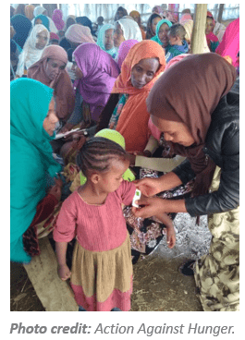
Research and Innovation: Simplified Approaches
2. Power of Nutrition (PON) Operational Research: Family MUAC
Aim and Objectives:
To generate evidence on the impact of Family MUAC on early identification and referrals, treatment outcomes, and screening and/or treatment coverage as compared to standard HEW-led community-based screenings.
To assess short- and longer-term caregiver measurement accuracy and frequency
Location: To be finalized
Donors and Partners: Funded by UNICEF, Power of Nutrition, Eleanor Crook Foundation, Rotary, END Fund, with co-funding from Action Against Hunger; in partnership with FMOH, UNICEF, EPHI, and UW
Significance for prevention and treatment of wasting in Ethiopia: Family MUAC could enable early detection and treatment of acute malnutrition, avoiding deterioration, cost-effectiveness of nutrition treatment programs.
For more information on the two operational research, please contact:
Heather Stobaugh Yosef Beyene Maria Wrabel
Principal Investigator Principal Investigator Research Project Coordinator
Action Against Hunger Ethiopia Public Health Institute (EPHI) Action Against Hunger
Email: hstobaugh@actionagainsthunger.org Email: yosef_beyene@yahoo.com Email: pon-pc@et-actionagainsthunger.org

Slide 62
Research and Innovation: Early Warning System/Nutrition Anticipatory Action
Modeling Early Risk Indicators to Anticipate Malnutrition (MERIAM 2.0):
Aim and Objectives:
To develop model for Early Warning System (EWS) to identify potential risks of hunger and malnutrition before they occur leveraging secondary data from various sources in disaster (e.g. drought and flood) prone areas.
To enhance the local Early Warning System capacity to prevent and mitigate hunger and malnutrition through the development of nutrition anticipatory action using predictive model.
Location: Girawa woreda in East Hararghe and Moyale Woreda, Borena.
Donors and Partners: Implemented by Action Against Hunger, Universities of Maryland (UMD) and Minnesota (UMN) in partnership with MoH and DRMC through funding from Funded by Germany Federal Foreign Office (GFFO)
Significance for prevention and treatment of wasting in Ethiopia:
Early Warning Systems will be established to identify potential risks of hunger and malnutrition before they occur using predictive model and secondary data. This will enable anticipatory actions to be taken proactively to prevent hunger and malnutrition.
Contingency plans will be developed to ensure that resources are pre-positioned and ready to be deployed in the event of an emergency.
Links Early Warning Systems and Disaster Risk Reduction efforts.
Help to prioritize intervention groups and areas, resource allocation and mobilization, scale up nutrition services and enhances community engagement.

Slide 63
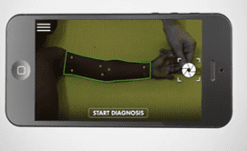
Research and Innovation: next research areas
1. SAM Photo diagnosis App.
SAM Photo App is an innovative mobile phone application that enables community health workers and families to screen children for severe acute malnutrition (SAM) and stunting (chronic malnutrition) by taking the photos of children U5.
Will be piloted in four countries in 2023 and it will be piloted and scaled up in 50 Action Against Hunger countries across the world.
2. Novel RUTF/plant based RUTF and local production.
Generating evidence on the safety, effectiveness and cost-effectiveness.
Assessing the local production cost of plant based RUTF and bringing RUTF manufacturing closer to the end user.
Significance of the innovations for prevention and treatment of wasting in Ethiopia:
SAM photo app creates a new standard in malnutrition screening, putting the power of a fast, accurate diagnosis in local hands, including communities.
Novel RUTF would create alternative solution to teat wasting in Ethiopia and elsewhere.
Note: Funding not secured for both initiatives as of this moment.
Notes:
Reducing the price, in theory, could allow more children to receive treatment. The production cost for milk and peanut based RUTF is relatively higher than plant based RUTF.
transportation time and supply chain barriers often delay or block the ability to get RUTF to the end user on time.
In line with:
WHO’s call for more research on non-milk formulations.
UNICEF’S new CODEX policy, which regulates RUTF formulations, does not require milk in RUTF

Slide 64
Monitoring, Evaluation and Learning: Nutrition Surveillance, Surveys and Investigations
SMART/SMART+: is a standardized methods that aims to estimate the prevalence of acute malnutrition among children of age 6-59 months and assess the mortality situation assess risk factors contributing to under-nutrition in a given location/area.
SMART+ is the most advanced and digitalized version that simplified survey and data management using digital technology and platform.
Semi-Quantitative Evaluation of Access and Coverage-SQUEAC: aims to estimate the wasting treatment coverage and factors (boosters and barriers) influencing the coverage as well as service utilization.
Standardized Expanded Nutrition Survey-SENS: is a standardized method applied to give us a detailed snapshot of the nutritional and health status of refugee population, including CU5 and WRAGs at a given point in time.
Link NCA (Nutrition Causal Analysis): aims to understand and analyze local causes and determinants of undernutrition to strengthen nutrition multisectoral response strategies.
HMIS/DHIS-2: serves as the main tool to monitor and evaluate the performance of the health system in Ethiopia. Key nutrition data elements and indicators have been included into the system. Building the capacity of HWs on utilization of routine nutrition data using HMIS/DHIS-2 has been the main focus area.
Significance for prevention and treatment of wasting in Ethiopia: help measure progresses, magnitude and severity of AM and other public health concern, information about wasting treatment coverage and help inform priority actions.
In addition, information from the above assessments will be used for FEWS NET, IPC and PIN determination in HNO/HRP.
Note: All assessments and surveys are conducted by Action Against Hunger.
Notes:
There are progresses made on increasing the geographic coverage of wasting treatment in Ethiopia but actual programme / treatement coverage remains low. (less than 50%)

Slide 65
Thank you for listening!
Muluneh Girma
HoD-Nutrition and health
Action Against Hunger
Email: nh-hod@et-actionagainsthunger.org

Slide 66


Slide 67


Slide 68


Slide 69
Where to go from here: call to action
Over the next 3 years, the total budget to be mobilized is 3.2 billion ETB, arround $60 million
The MOH is committed to the action plan and is contributing domestic resources to execute the plan
Wasting integration is currently embedded within the MOH’s annual plan as a priority area
Still, fulfilling the action plan requires support from all development partners
  Funding support
  Technical assistance
  Collaborative learning and adaptation
Please consider: how can your institution help support this strategic plan?
  Provide funding to support one of the strategic initiatives in the plan
  Review and tailor existing work already underway to support the plan
  Help us generate new evidence to strengthen programming and planning
  Help us strengthen capacity at subnational levels to implement the plan

Slide 70


